Slide 1
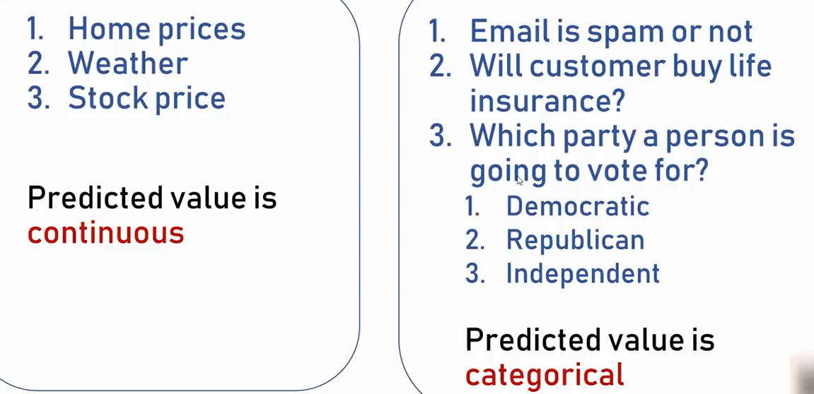
Regression Classification

Slide 2
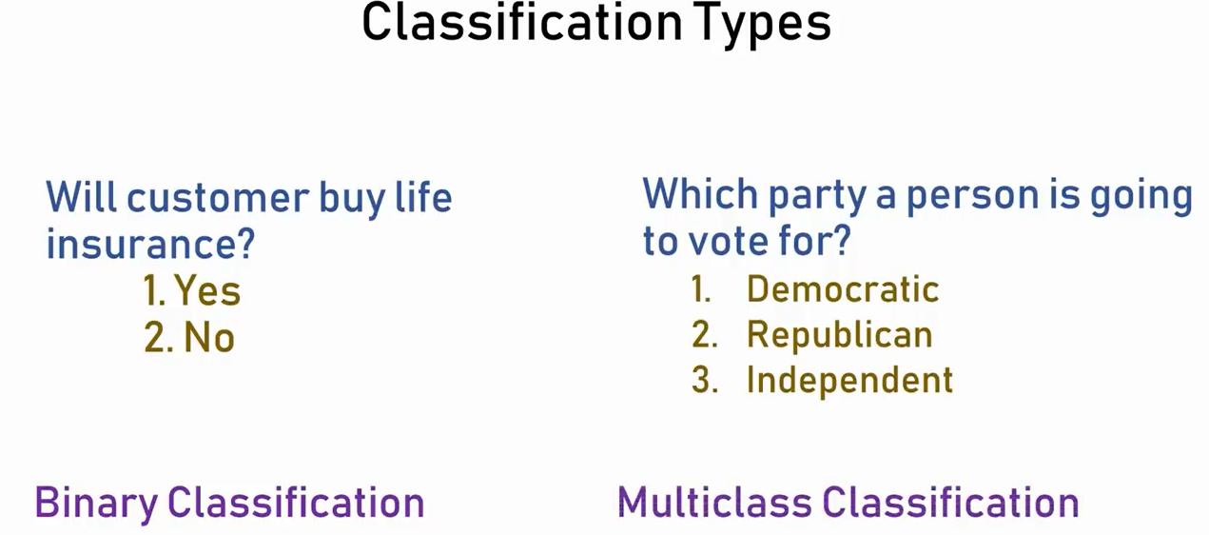
Logistic Regression is one of the techniques used in Classification and it is a binary classification algorithm.

Slide 3
What is Logistic Regression?
Logistic regression is the appropriate regression analysis to conduct when the dependent variable is dichotomous (binary). Like all regression analysis, logistic regression is a predictive analysis.
It is used when our dependent variable is dichotomous or binary. It just means a variable that has only 2 outputs, for example, A person will survive this accident or not, The student will pass this exam or not. The outcome can either be yes or no (2 outputs).
So, logistic regression is only used when the dependent variable is binary and in linear regression this dependent variable is continuous.

Slide 4
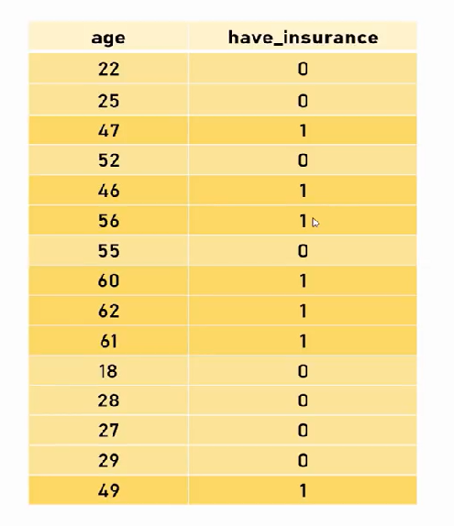
Why do we use Logistic regression and not Linear regression? Consider the following dataset example. Independent variable is age and corresponding Y value is whether the person has insurance or not (value is 0(no insurance) or 1(has insurance).

Slide 5
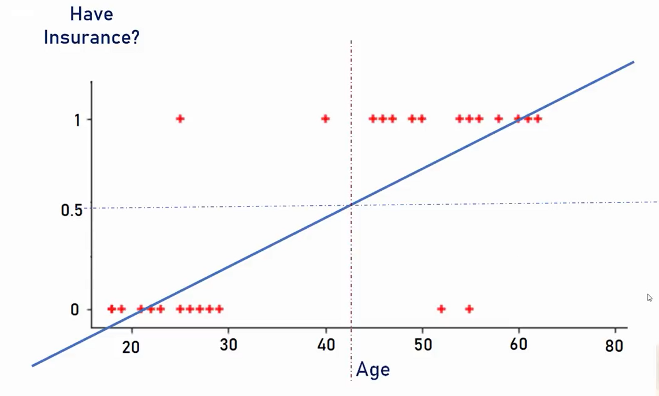
If we consider the following scatter plot, 80% of cases is working fine with this regression line.

Slide 6
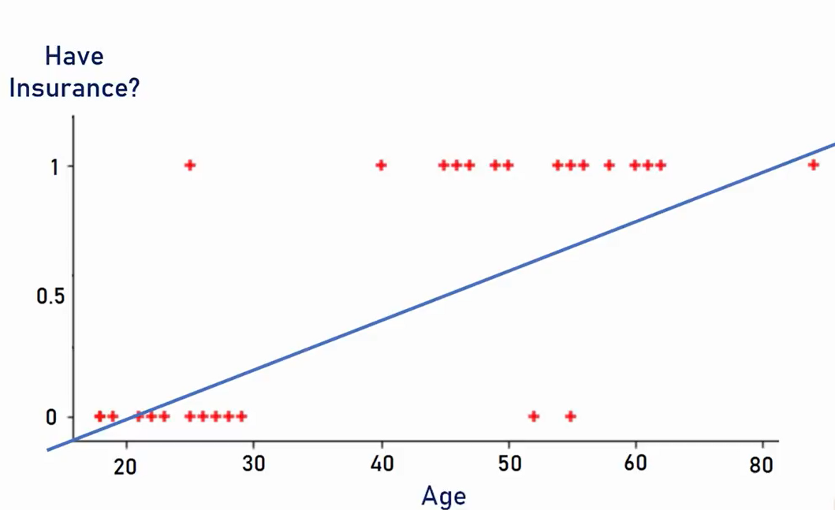
The trend here is that persons who are of younger age do not have an insurance. So it is likely that a person with age 80 will have an insurance but in this below graph we can see simple linear regression line is not working fine as it is classifying the data is having no insurance. Same is the case with a person with age 25, where the classification shows that the person is having insurance, hence simple linear regression is not working fine.

Slide 7
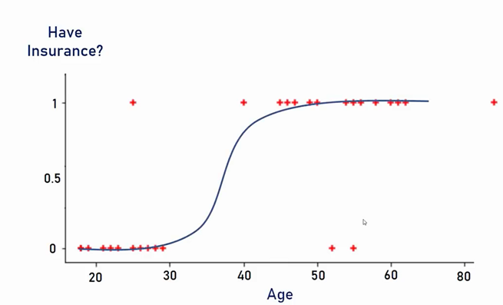
Let us imagine that this type of curve is present. This is a much better fit.

Slide 8
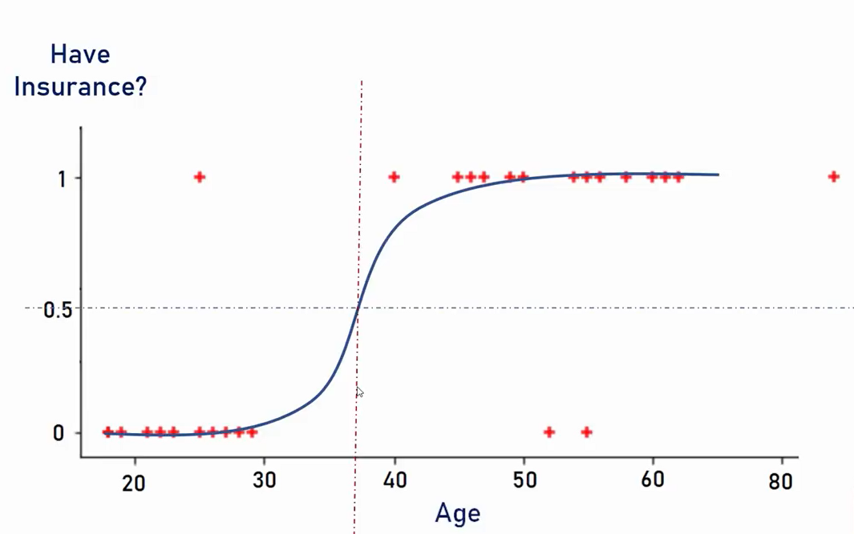
This curve is a S-shaped curve. And it classifies all the data points perfectly.

Slide 9
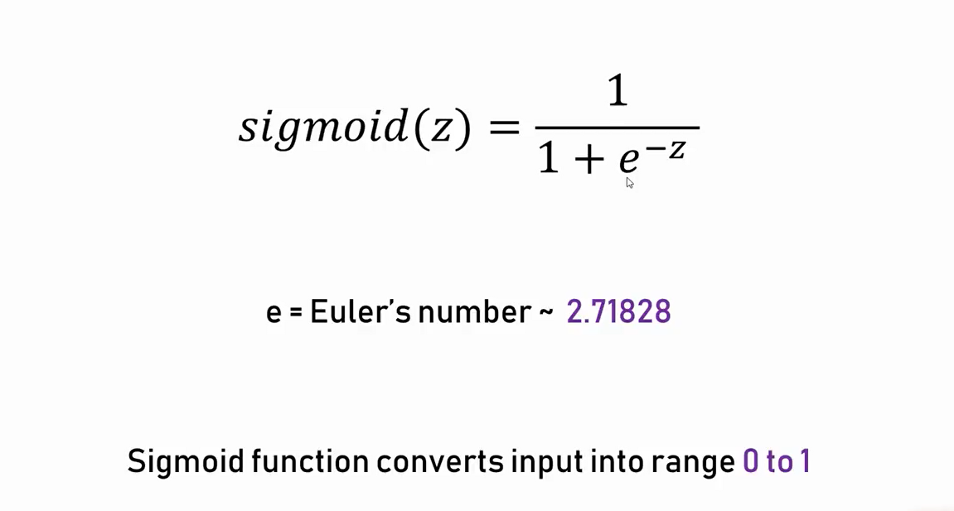
Standard logistic function or Sigmoid Curve

Slide 10

How logistic regression squeezes the output of linear regression between 0 and 1
Below is the formula of logistic function:
We all know the equation of the best fit line in linear regression is:
Y = b0 + b1x

Slide 11
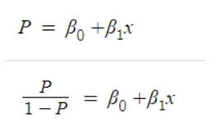
Let’s say instead of y we are taking probabilities (P). But there is an issue here, the value of (P) will exceed 1 or go below 0 and we know that range of Probability is (0-1). To overcome this issue we take “odds” of P:
Do you think we are done here? No, we are not. We know that odds can always be positive which means the range will always be (0,+∞ ). Odds are nothing but the ratio of the probability of success and probability of failure.

Slide 12

Log Odds / Logit Function
It is difficult to model a variable that has a restricted range. To control this we take the log of odds which has a range from (-∞,+∞).
Now we just want a function of P because we want to predict probability right? not log of odds. To do so we will multiply by exponent on both sides and then solve for P.

Slide 13
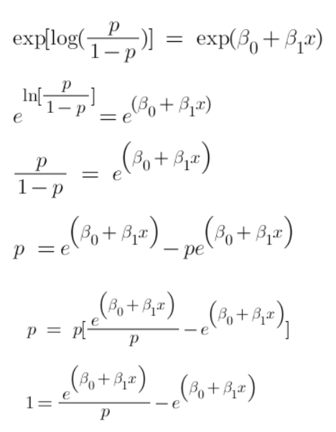

Slide 14
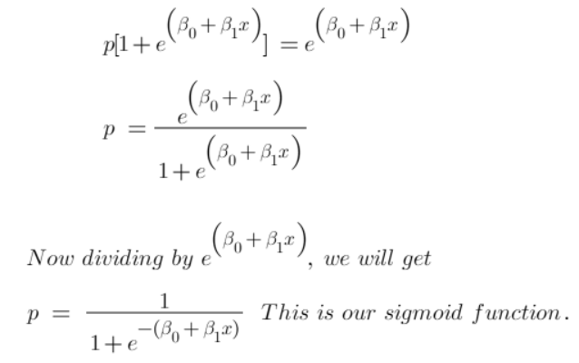
This sigmoid function squeezes a straight line to a S –shape curve.

Slide 15
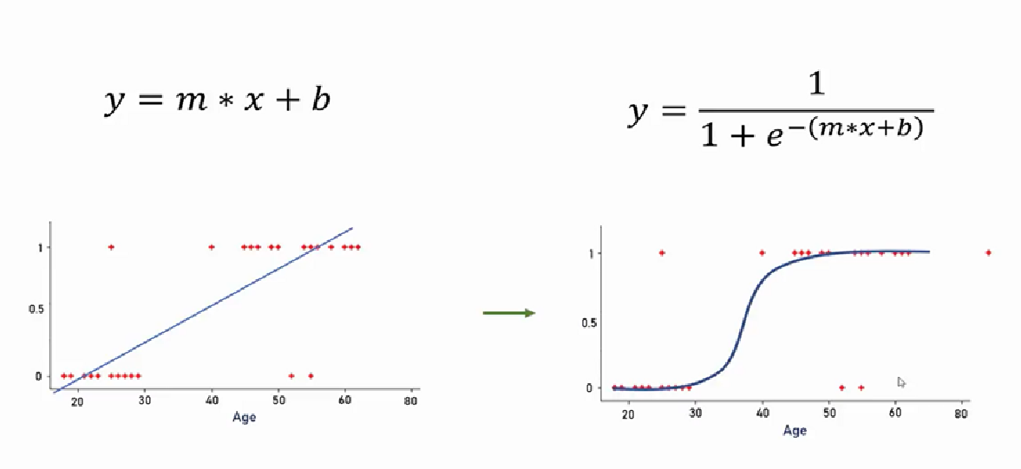
Linear Regression Sigmoid or Logit Function

Slide 16
Examples of Binary Classification Model
Spam detection – spam or not
Credit Card fraud detection – is fraud or not
Cancer detection – either malignant or benign
Marketing – Will user deposit in a term deposit or not
Banking – Will customer take a loan or not
In logistic regression, we get a probability score that reflects the probability of occurrence of the event, in contrast to linear regression which gives the actual output.

Slide 17
Types of Logistic Regression:
On the basis of the categories, Logistic Regression can be classified into three types:
Binomial: In binomial logistic regression, there can be only two possible types of the dependent variables, such as 0 or 1, Pass or Fail, etc.
Multinomial: In multinomial Logistic regression, there can be 3 or more possible unordered types of the dependent variable, such as "cat", "dogs", or "sheep"
Ordinal: In ordinal Logistic regression, there can be 3 or more possible ordered types of dependent variables, such as “Low", "Medium", or "High".

Slide 18
Thank You -Prepared by Jheelam Mondal Assistant Professor CSE Department Haldia Institute of Technology

